Slide 1
1.4 Decimals
Students will be able to:
Round, add, subtract, multiply and divide decimals.
Convert decimals, fractions, and percents.
Simplify expressions with square roots.

Slide 2
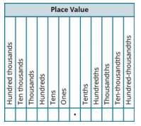

Slide 8
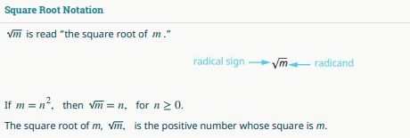

Slide 10
