Slide 1
2.5 Solve Linear Inequalities
Students will be able to:
Graph inequalities on the number line
Solve linear inequalities
Solve applications with linear inequalities

Slide 2
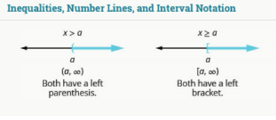

Slide 6
