Slide 1
2.7 Solve Absolute Value Inequalities
Students will be able to:
Solve absolute value equations
Solve absolute value inequalities
Solve applications with absolute value

Slide 3
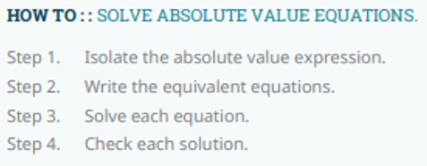

Slide 7
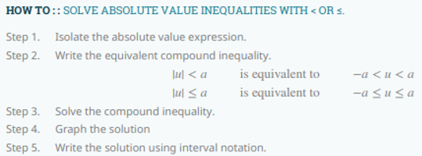

Slide 9
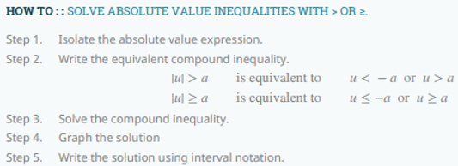

Slide 11
The diameter of the rod can be
between 59.925 mm and 60.075 mm

