Slide 1
3.1 Graph Linear Equations in Two Variables
Students will be able to:
Plot points on the coordinate plane
Graph a linear equation by plotting points
Graph vertical and horizontal lines
Find x- and y-intercepts
Graph using intercepts

Slide 2
Coordinate Plane

Slide 3
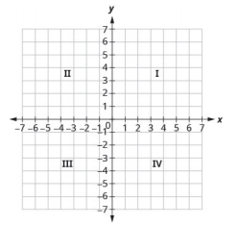
a
e
d
c
b

Slide 5
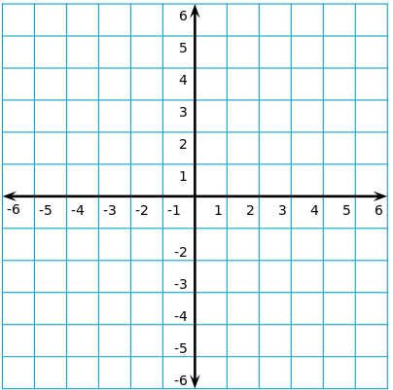

Slide 9
X intercept
Y intercept

Slide 10
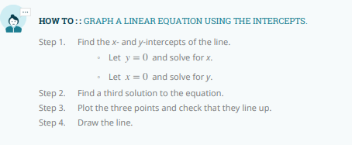
X intercept
Y intercept

Slide 11
X intercept
Y intercept

