Slide 1
3.6 Graphs of Functions
Students will be able to:
Use the vertical line test
Identify graphs as basic functions
Read information from a graph of a function

Slide 2
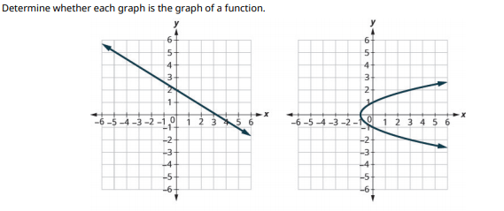

Slide 3
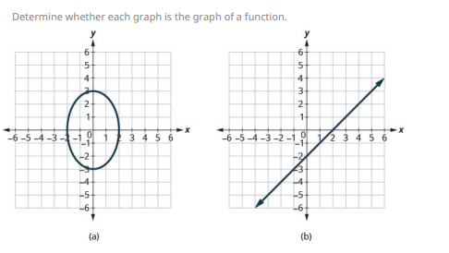
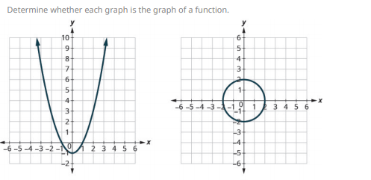

Slide 4
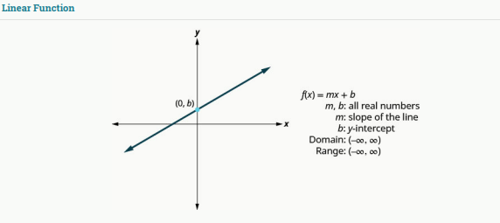

Slide 5
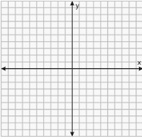

Slide 6
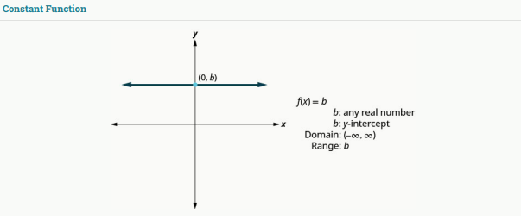

Slide 7
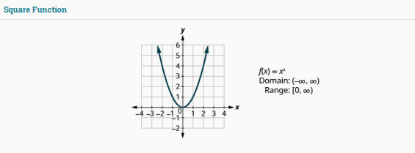
Graph the function , then state its domain and range in interval notation.

Slide 8
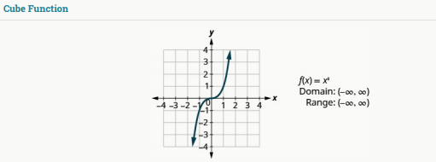
Graph the function , then state the domain and range in interval notation.

Slide 9
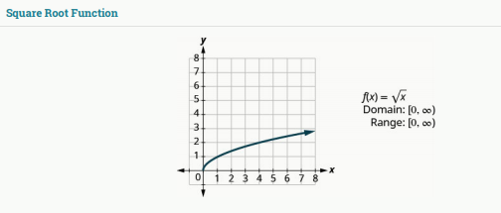
Graph , then state the domain and range in interval notation.

Slide 10
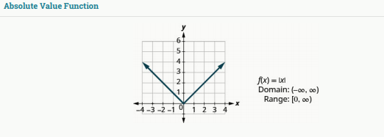
Graph , then state the domain and range in interval notation.

Slide 11
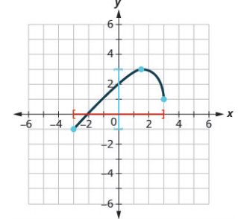
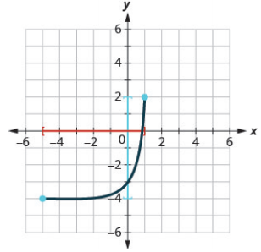

Slide 12
