Slide 1
3.5 Relations and Functions
Students will be able to:
Find the domain and range of a relation
Determine in a relation is a function
Find the value of a function

Slide 3
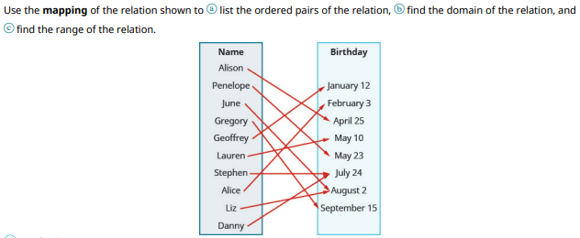

Slide 4
