Slide 1
1.1 Use the Language of Algebra
Students will be able to:
Find factors, prime factorizations, and LCM
Use variables and algebraic symbols
Simplify expressions using the order of operations
Evaluate an expression
Identify and combine like terms
Translate an English phrase to an algebraic expression

Slide 2
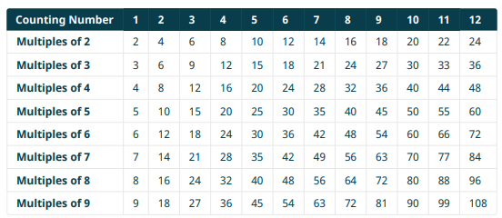

Slide 3
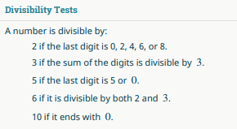

Slide 8
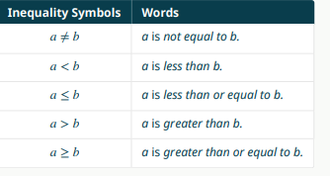

Slide 10
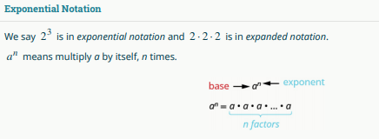

Slide 11
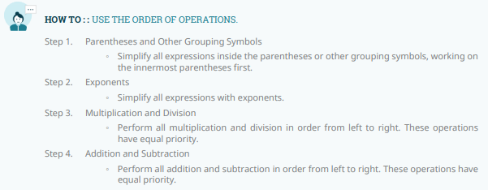

Slide 15
