Slide 1
9.2 Completing the Square

Slide 2
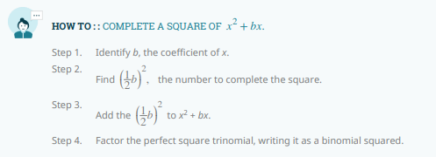

Slide 4
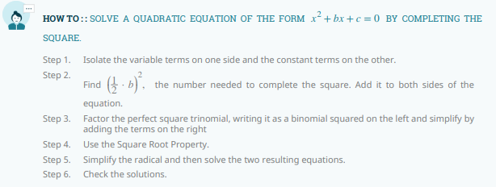

Slide 5
