Slide 1
9.8 Solve Quadratic Inequalities

Slide 2
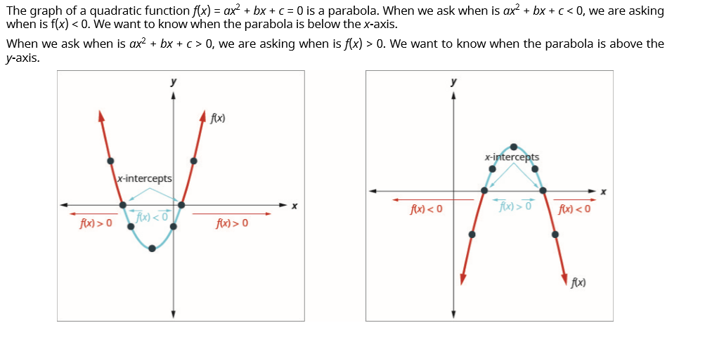

Slide 6
Solve $−x^{2}−8x−12≤0$

Slide 7
Special Cases

