Slide 1
10.1 Finding Composite and Inverse Functions

Slide 5
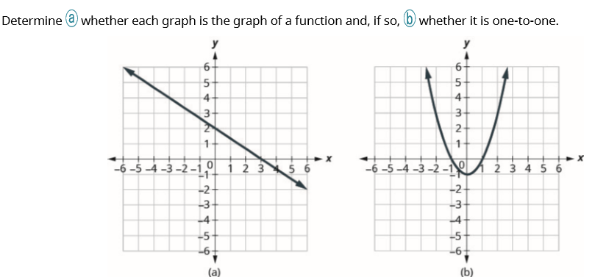

Slide 7
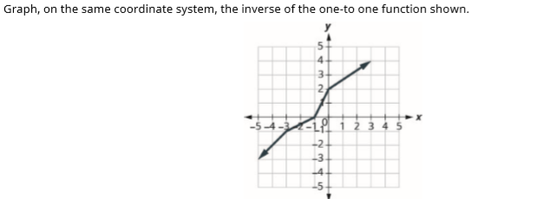

Slide 9
