Slide 1
10.4 Use the Properties of Logarithms

Slide 3
If bases are the same, the functions undo each other.

Slide 4
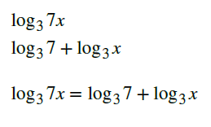

Slide 5
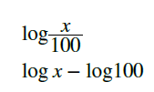

Slide 7
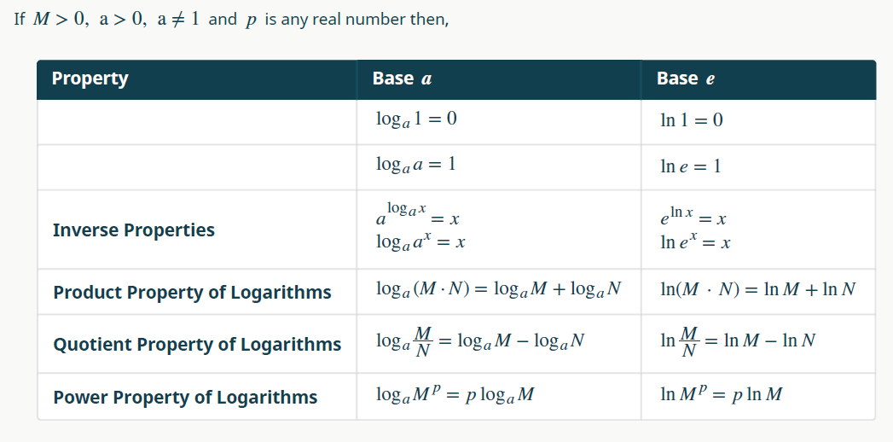

Slide 9
