Slide 1
10.2 Evaluate and Graph Exponential Functions

Slide 3
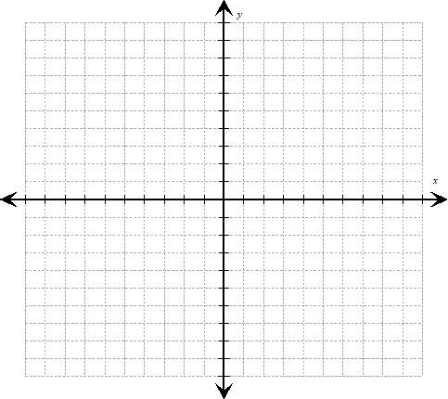

Slide 4
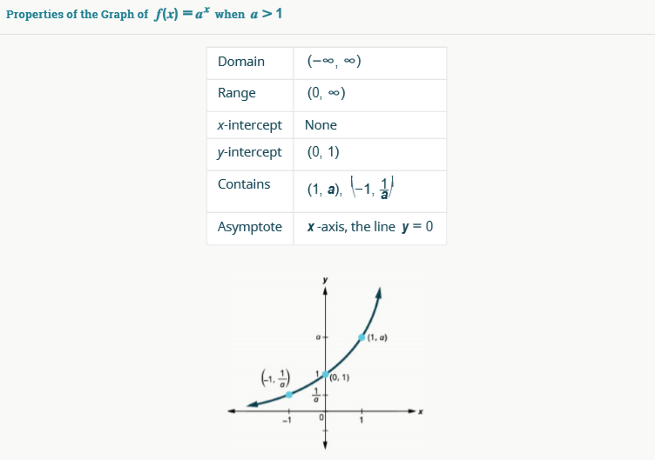

Slide 5
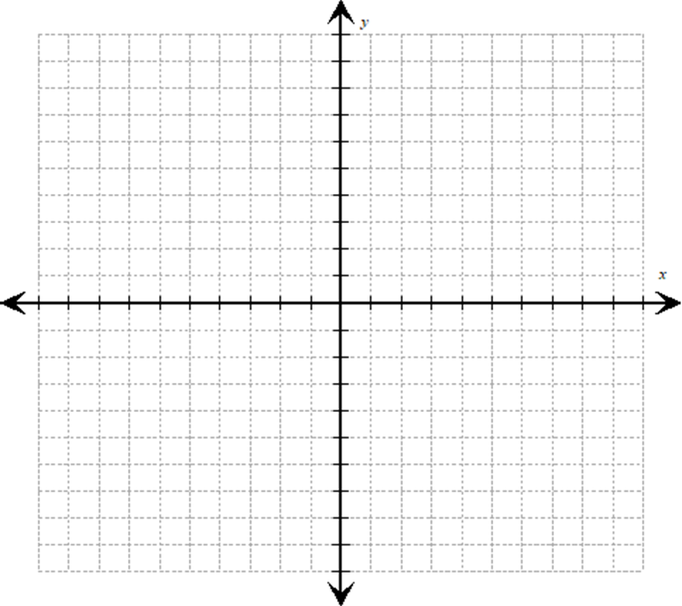

Slide 6
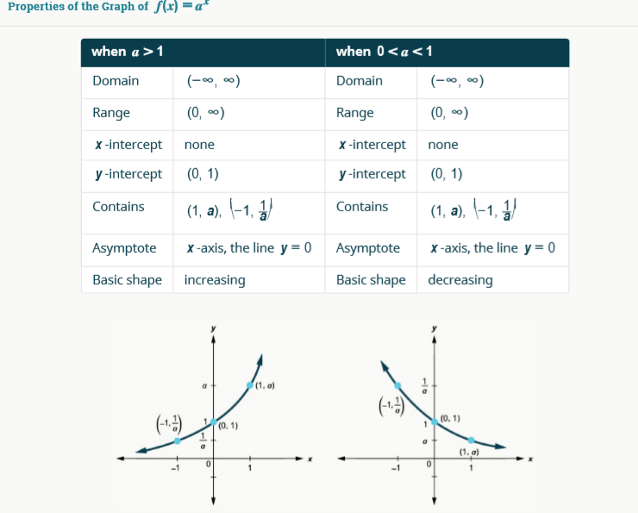

Slide 9
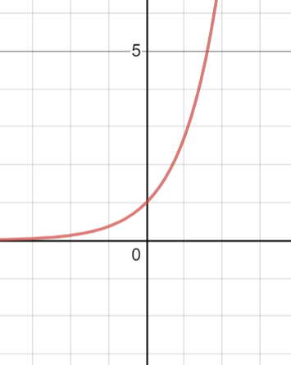

Slide 14
Chris is a botanist trying to understand the behavior of algae newly growing in his state. He starts his experiment with 100 algae that grows at a rate of 25% per hour. He will check on the algae in 24 hours. How many algae will he find?

