Slide 1
11.2 Applications of Parabolas

Slide 4
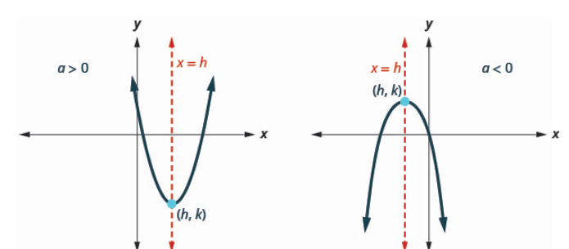

Slide 5
